Slide 1

e-SHOPPING MART WEB APPLICATION
Internship Project – B.Sc IT
5th Semester

Slide 2
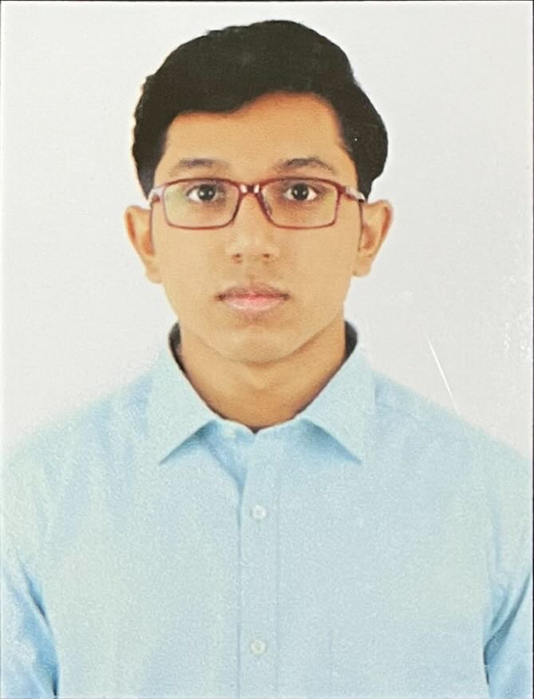
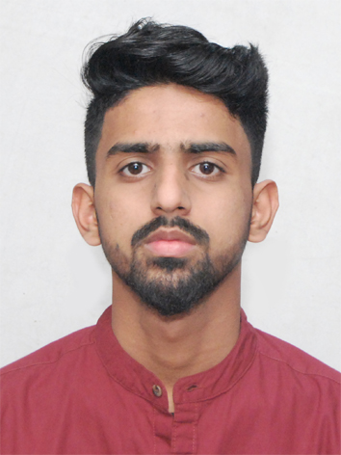
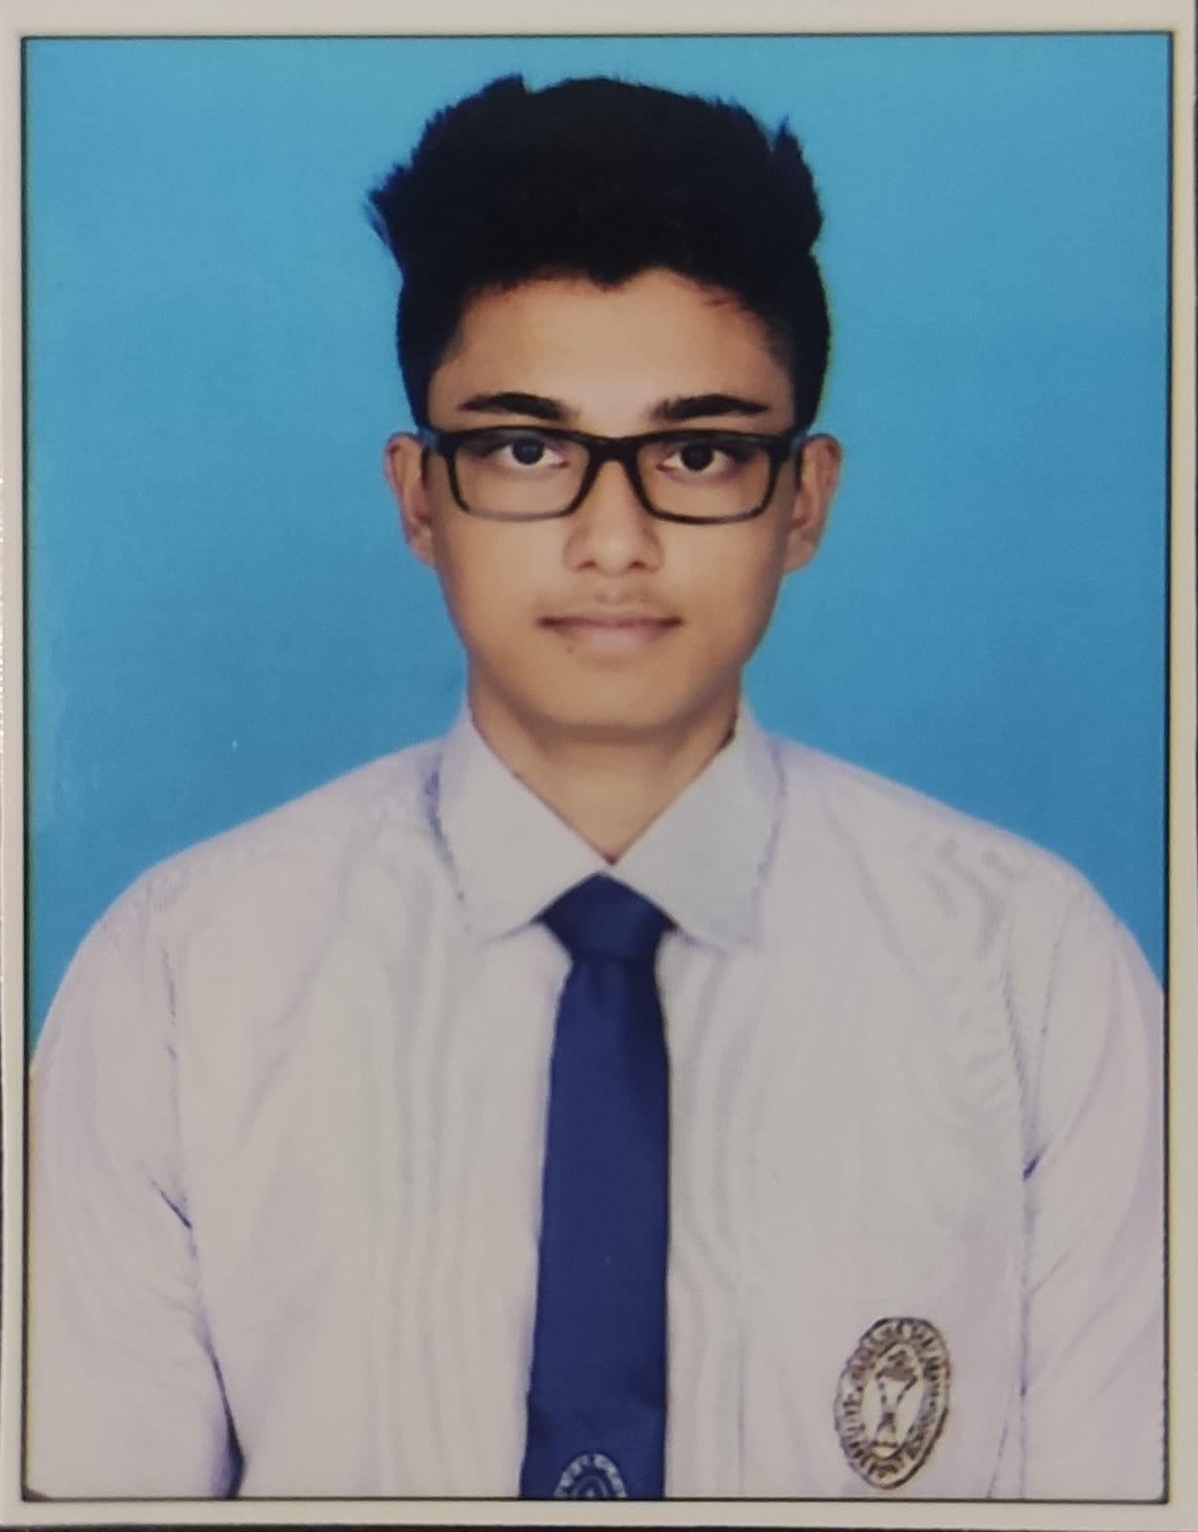
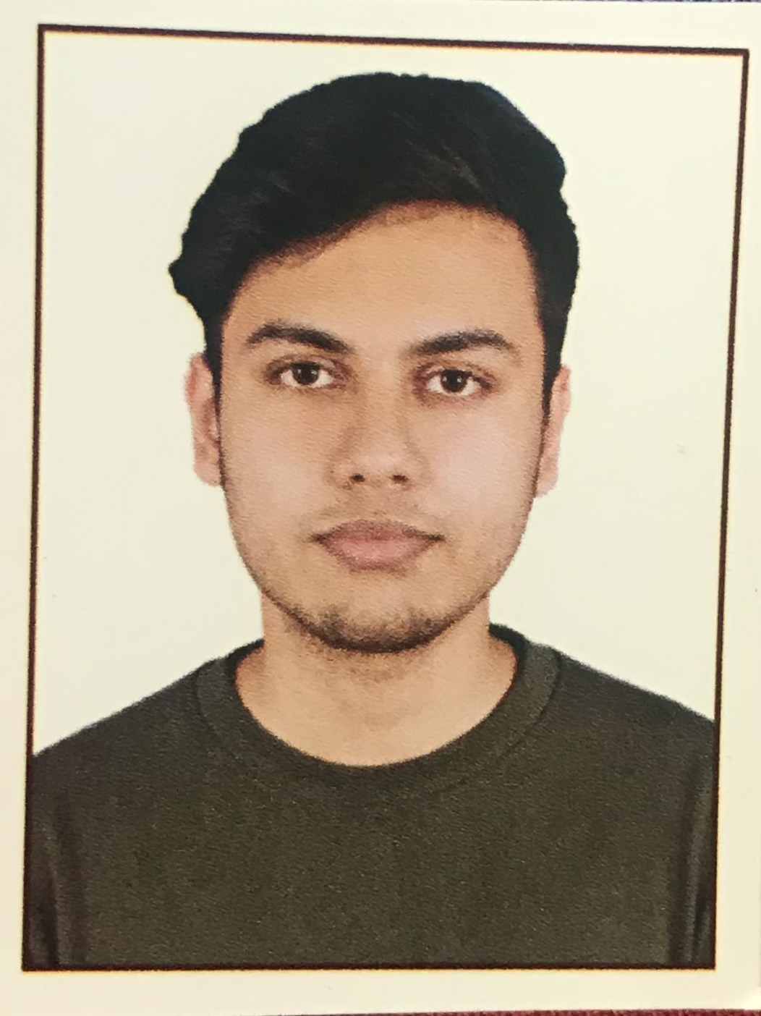
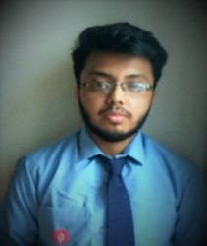
Team (Department of Computer application):
DEBOPRIYO ROY
GOPAL PACHERIYA
ANIRUDHYA PAUL
PIYUSH ROY CHOWDHURY
SOUVIK PAUL
Student ID: 191001111019
Registration Number: 1001911481
Student ID: 191001111010
Registration Number: 1001911472
Student ID: 191001111008
Registration Number: 1001911470
Student ID: 191001111018
Registration Number: 1001911480
Student ID: 191001111024
Registration Number: 1001911486
Under the Guidance of
Mr. Tapas Kumar Mitra,
Techno India University, West Bengal

Slide 3

ACKNOWLEDGEMENT
Firstly, we would like to thank Professor Anil Bikash Chaudhuri, Head of Department, Computer Application, Techno India University for giving us the opportunity to do an internship project within the institution. We would also like to appreciate the team work, with each member devoting their patience and openness, creating an enjoyable working environment.
It is indeed with a great sense of pleasure and immense sense of gratitude that we acknowledge the help of fellow individuals. We are indebted to Mr. Tapas Kumar Mitra for the guidance provided to accomplish this project.
We are extremely grateful to our department facilities’ lessons that helped us in successful completion of this internship project.

Slide 4

ABSTRACT
The project is grounded on evolving an e-commerce website to facilitate people with shopping inside the comfort of their home. In this unsolicited COVID-19 pandemic situation, people have limited themselves from regular shopping places due to the mass gathering. But this cannot confine peoples’ need or desire for shopping. Keeping both the privileges in mind, this e-shopping web site is developed.
‘But where in the world a shopping web site, many already exists?’ is the first query that hits the mind, right! In that context, not unique but far better structures are implied in the web site. To commence with, shopping form the web site, one can –
Directly place order to the manufacturer
Get massive options of clothing, wearable, electronic devices, and many more
Take benefit of scheduled delivery even with regular charges
Get choice of shopping from various brands
Rank the priorities using filters containing more extended selections
On the other flip, the transport process is smoother along with maintaining all the safety measures in order to keep the customers protected from contact of any virus. Listed partners are responsible to reach doorstep upholding contactless delivery.

Slide 5
INTRODUCTION
Technical development of the shopping web site is well-thought-out in the project. The strategies and relativeness of the functioning codes are also sketched to understand the outlines of the overall methodology.
The Applications for Front-end development:
HTML,
Java,
JavaScript and
CSS
The Back-end is attempted with MySQL. The connectivity is holding parallel importance and is ended using Tomcat server.
Every individual member of the team was assigned with specific task. Perceiving the team strength, the work was divided into 5 parts – such as web programming, context development, web designing, database alignment, and report making. All these portions are very crucial to wide-range such a satisfying project and without team work, it was moderately impossible.

Slide 6
SYSTEM SPECIFICATIONS
OS Edition Windows 10 Home Single Language
Version 21H2
Processor Intel(R) Core(TM) i5-8265U CPU @ 1.60GHz 1.80 GHz
Installed RAM 8.00 GB (7.85 GB usable)
System type 64-bit operating system, x64-based processor
Installed software:
Eclipse IDE – JDK 2021-12
Apache Tomcat 10.0.14
MySQL workbench 8.0.28

Slide 7

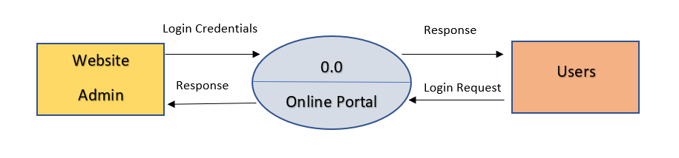
SYSTEM DESIGN
Data Flow Diagram(s):
Context Level for Admin Side :

Slide 8
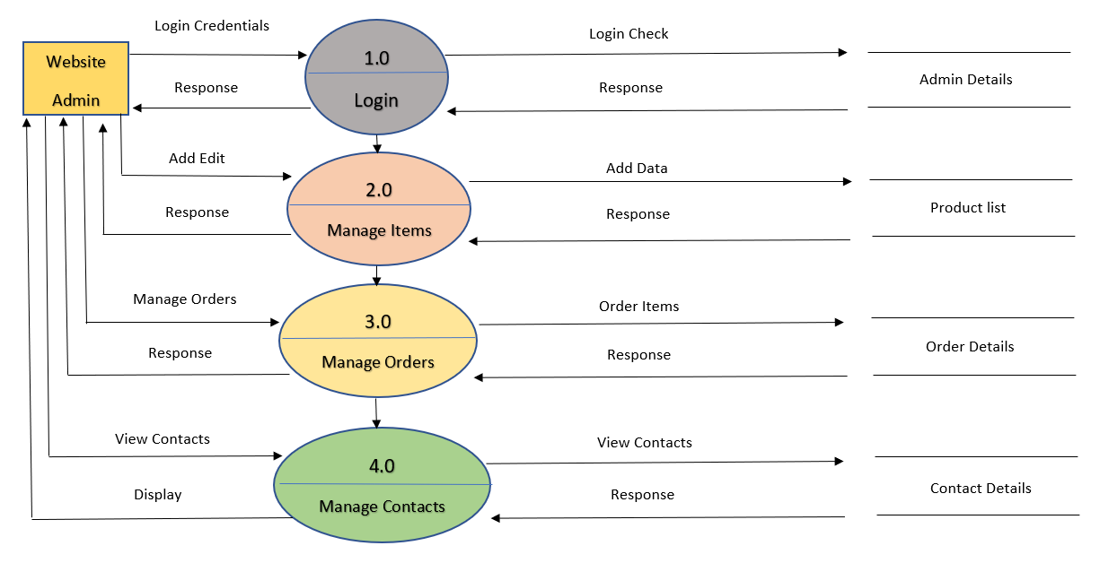
SYSTEM DESIGN
1st Level for Admin Side :

Slide 9
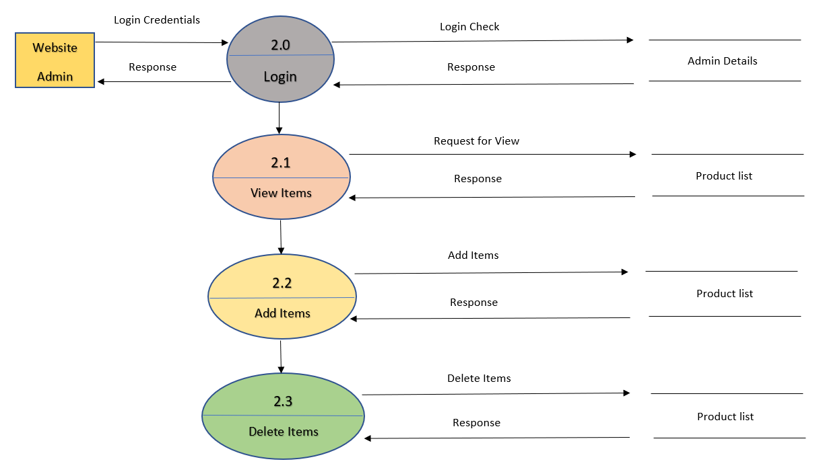
SYSTEM DESIGN
2nd Level for Admin Side (2.0):

Slide 10
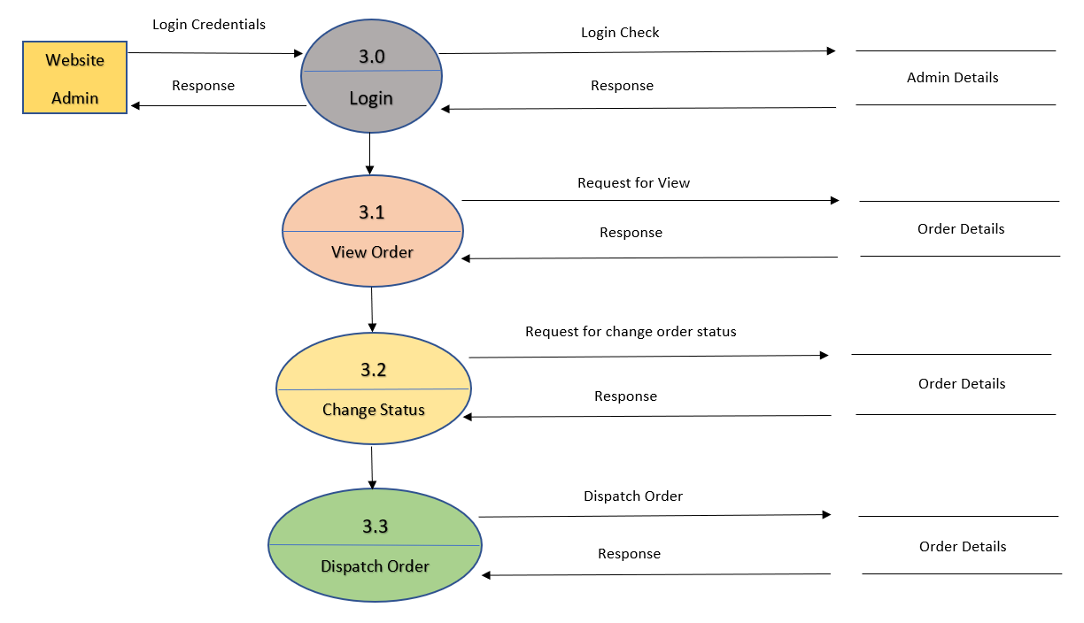
SYSTEM DESIGN
2nd Level for Admin Side (3.0):

Slide 11
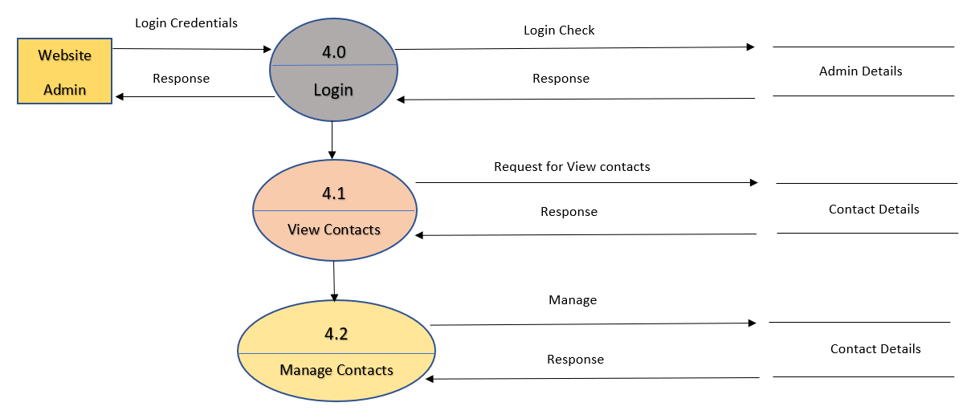
SYSTEM DESIGN
2nd Level for Admin Side (4.0) :

Slide 12
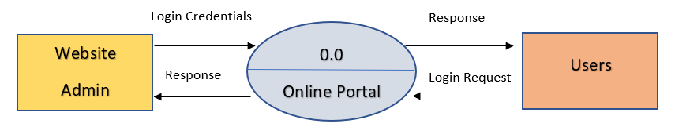
SYSTEM DESIGN
Context Level for User Side :

Slide 13
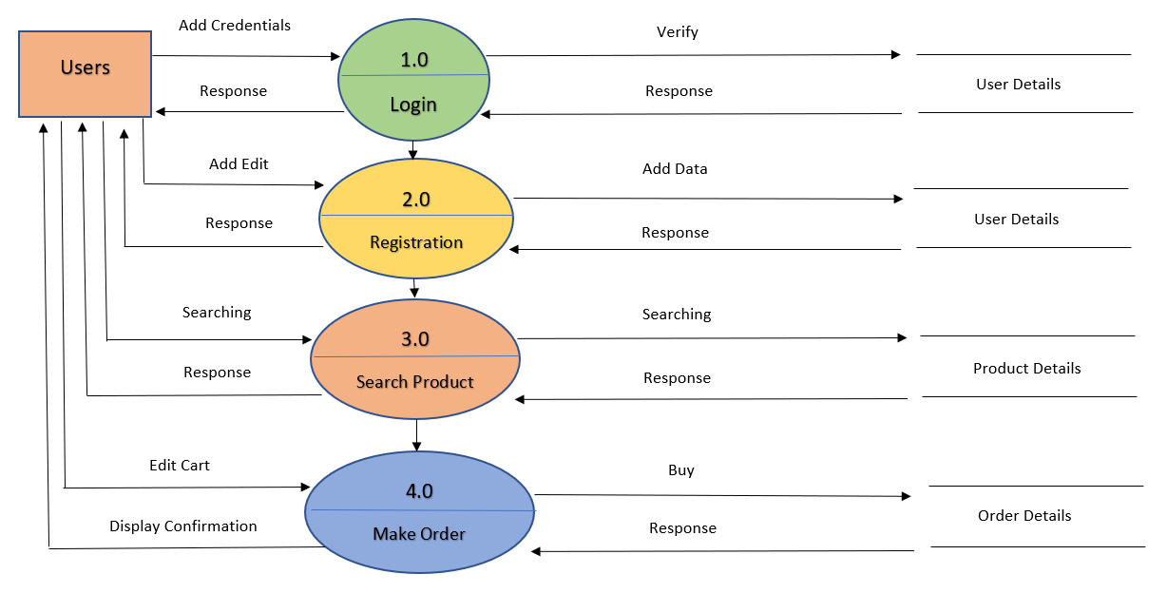
SYSTEM DESIGN
1st Level for User Side:

Slide 14
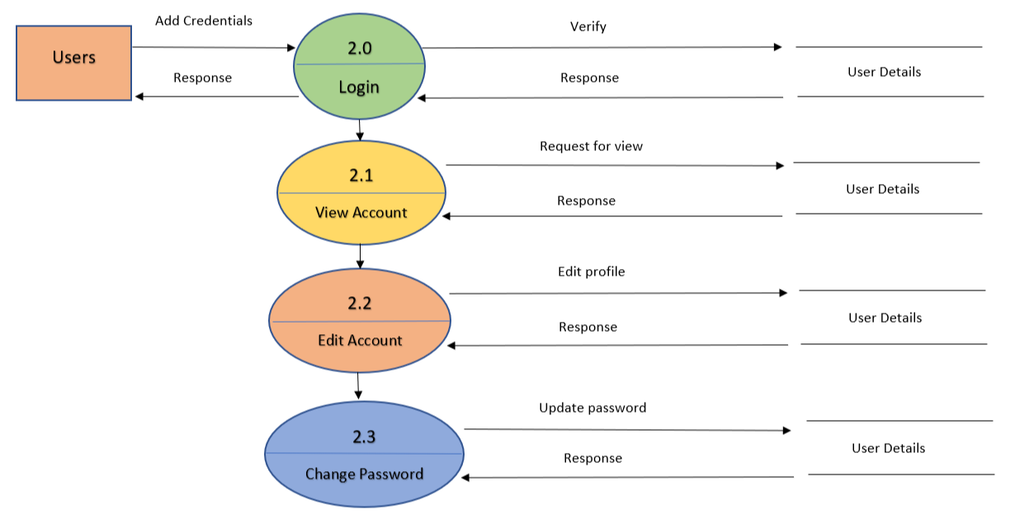
SYSTEM DESIGN
2nd Level for User Side (2.0):

Slide 15

SYSTEM DESIGN
2nd Level for User Side (3.0):

Slide 16
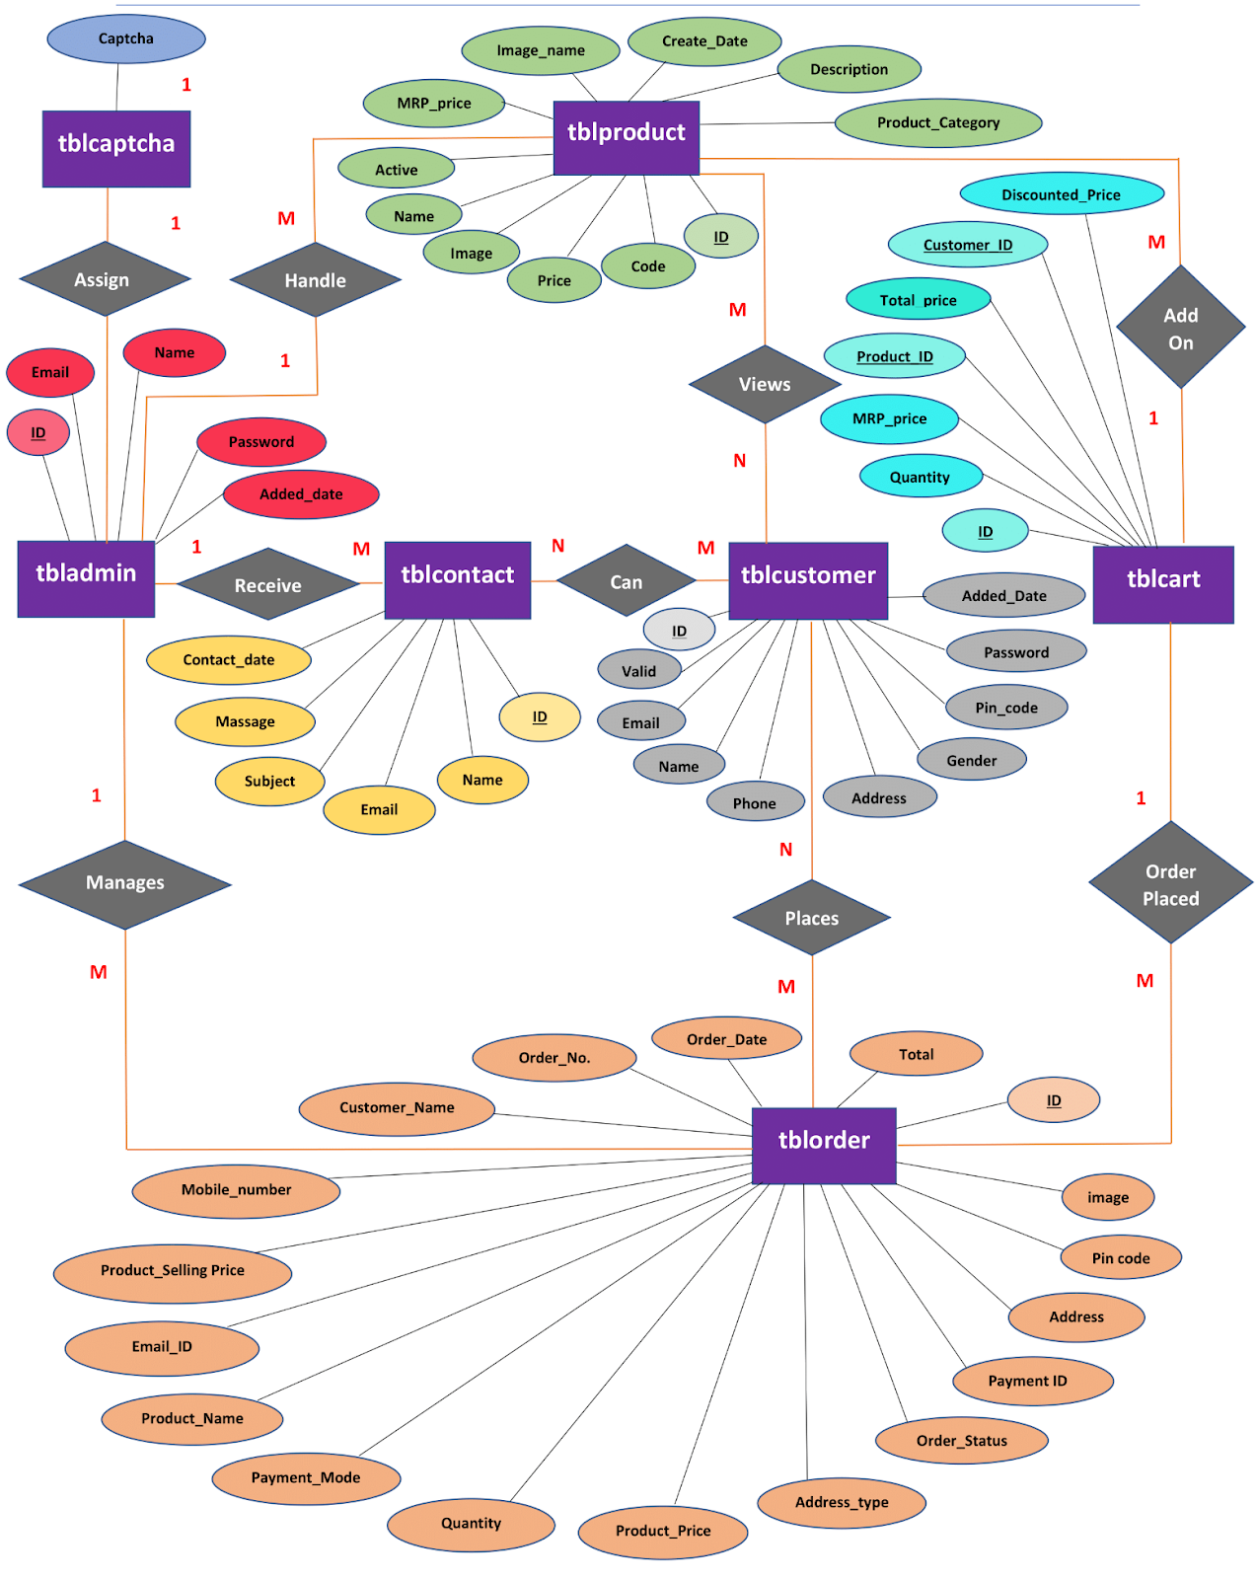
SYSTEM DESIGN
ER-Diagram:

Slide 17
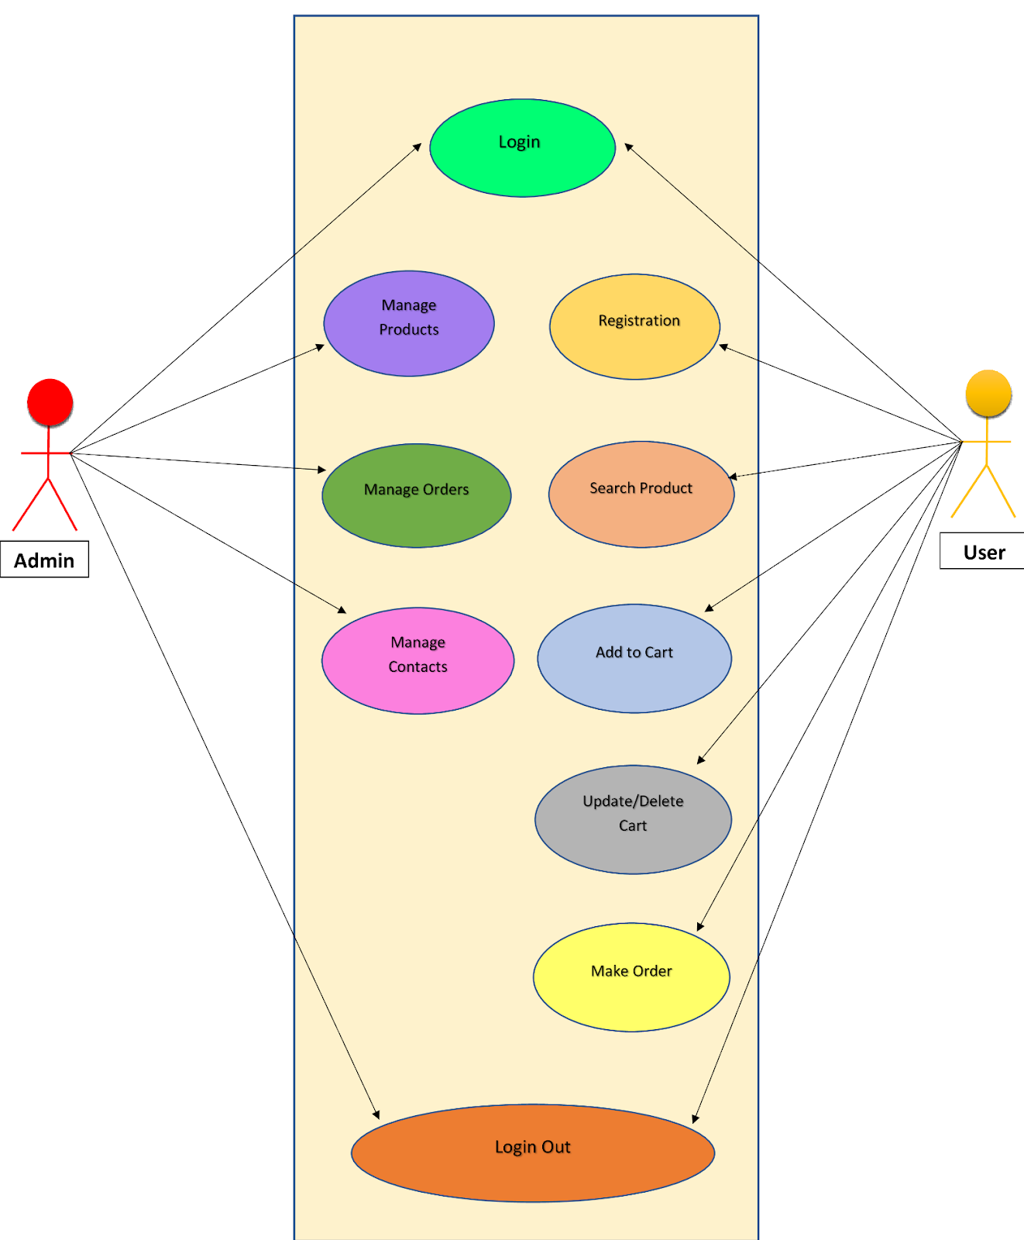
SYSTEM DESIGN
Use Case Diagram:

Slide 18
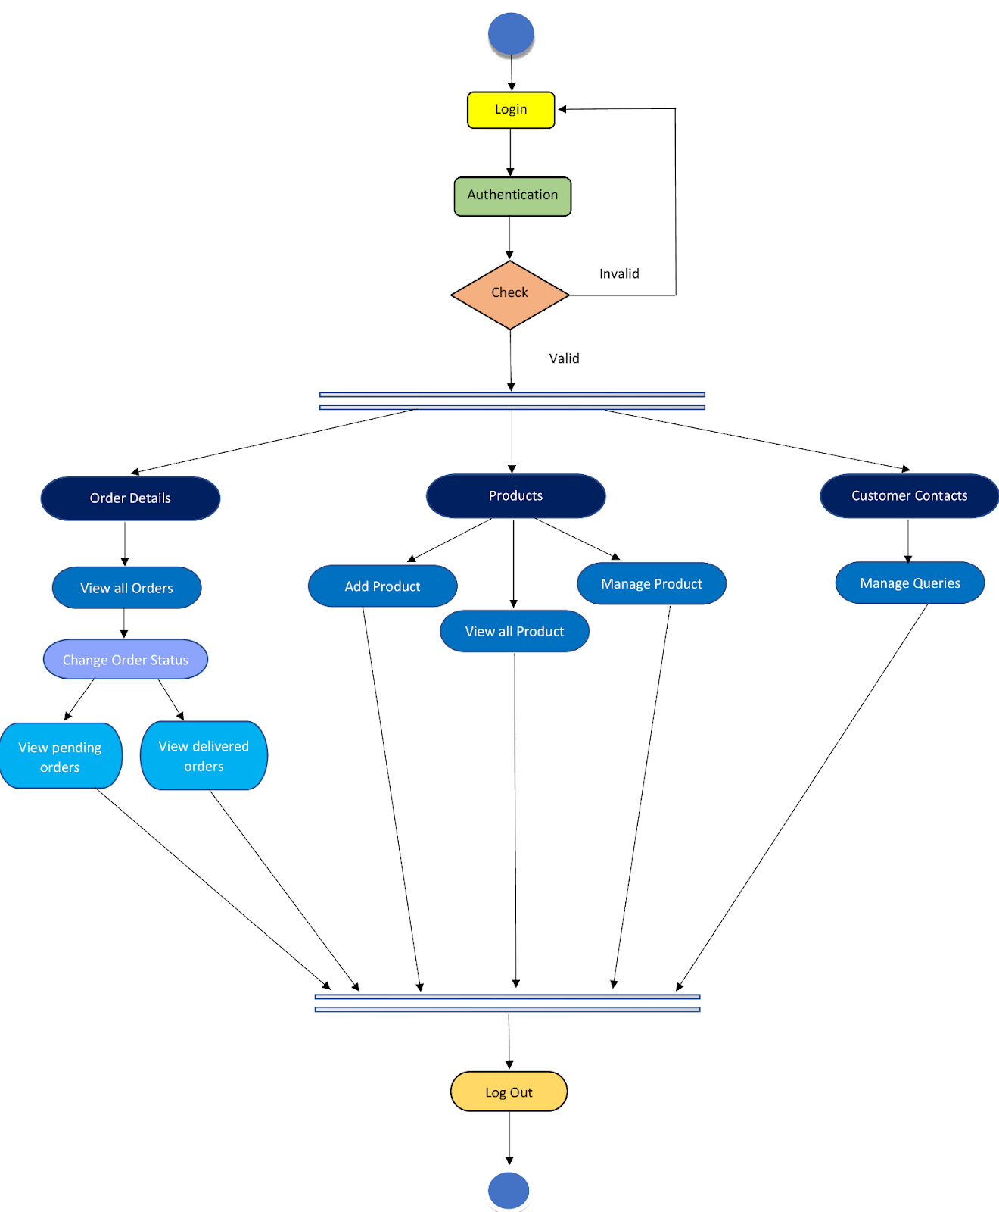
SYSTEM DESIGN
Activity Diagram for Admin Side:

Slide 19
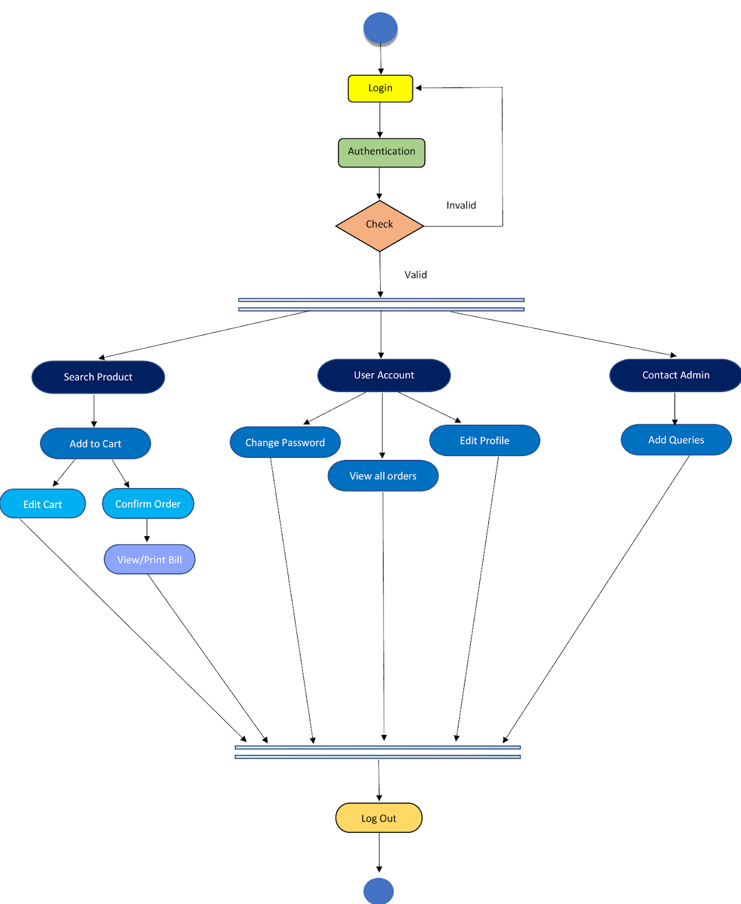
SYSTEM DESIGN
Activity Diagram for User Side:

Slide 20
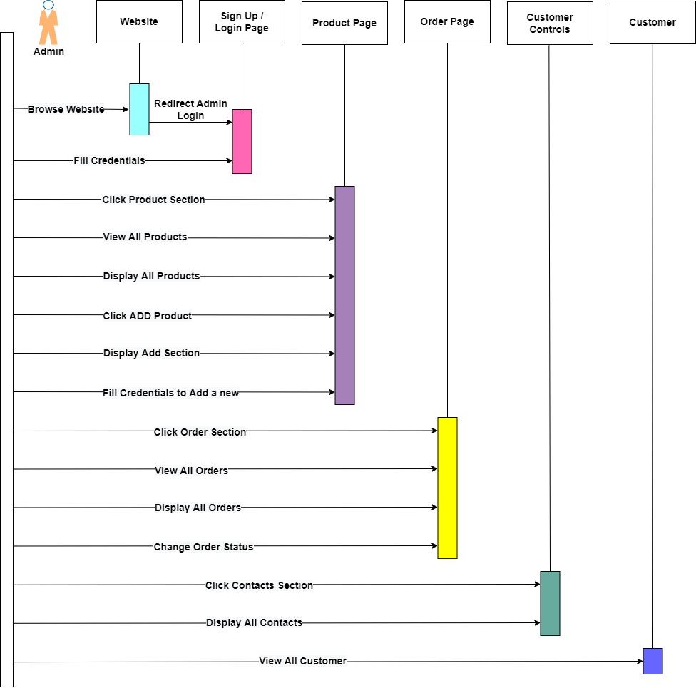
SYSTEM DESIGN
Sequence Diagram for Admin Side:

Slide 21
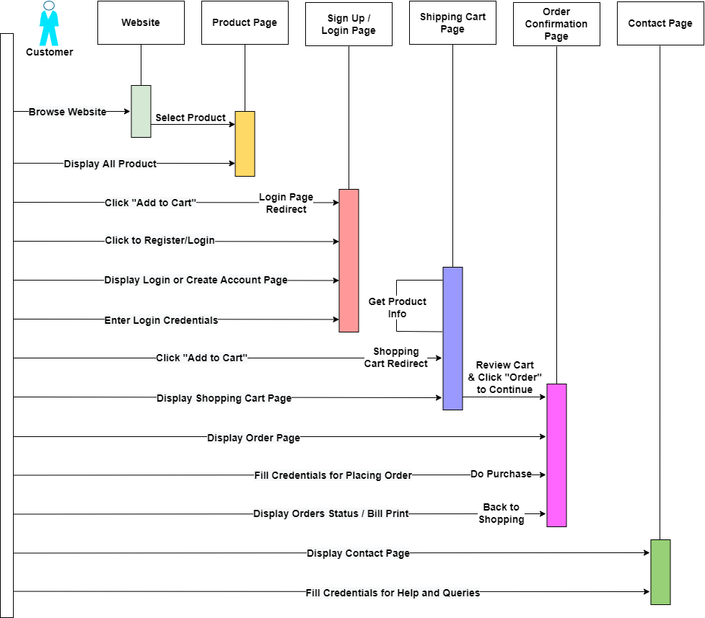
SYSTEM DESIGN
Sequence Diagram for User Side:

Slide 22
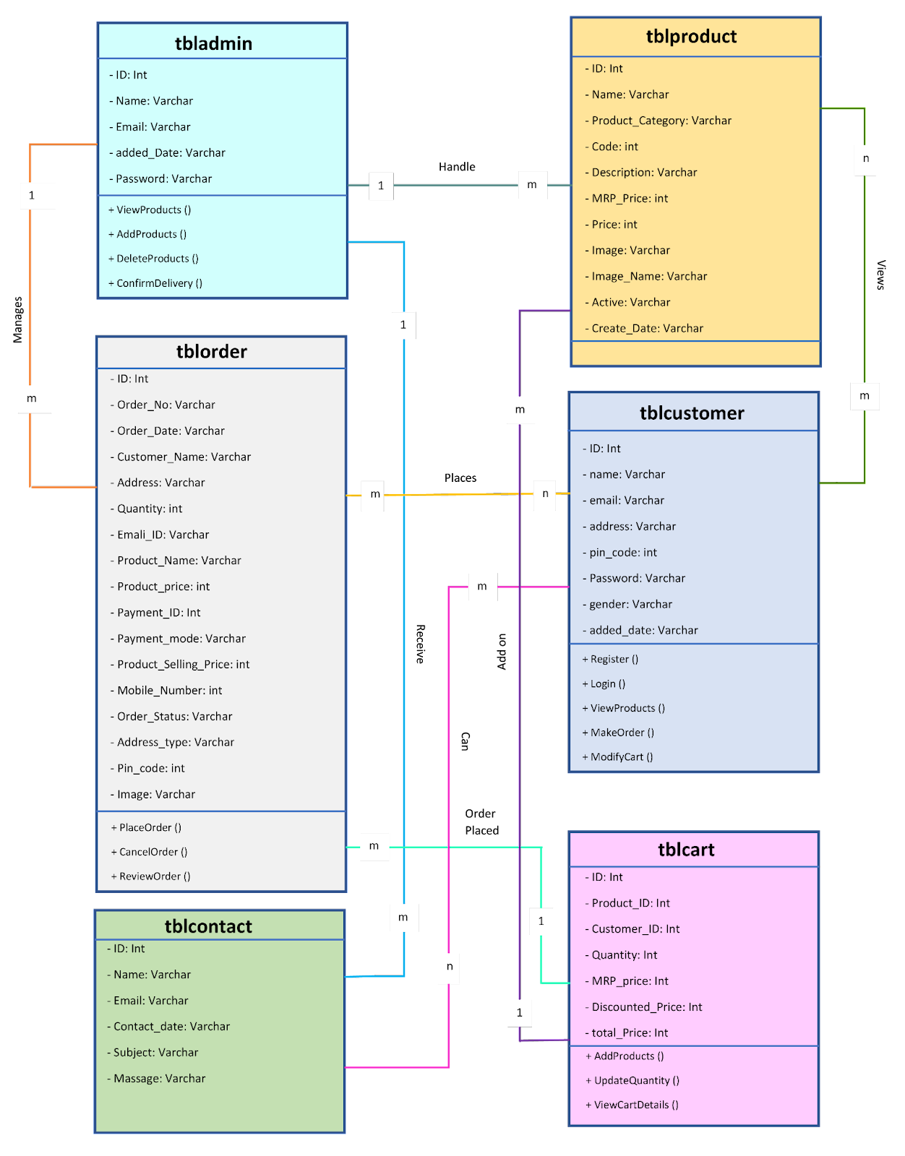
SYSTEM DESIGN
Class Diagram:

Slide 23

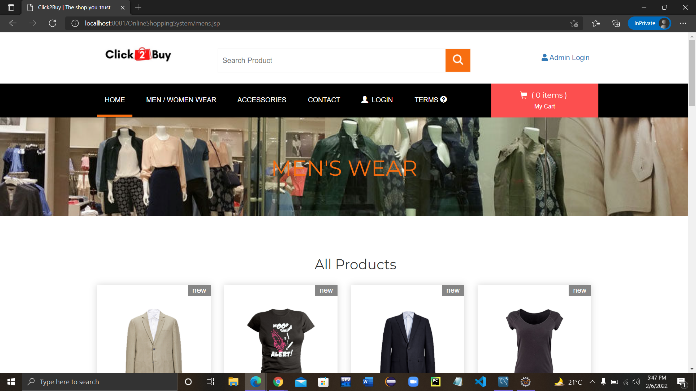
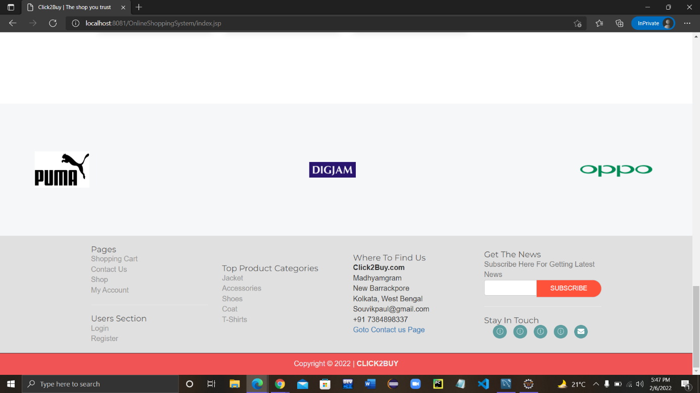
Website Pages & Database demonstrations
User Interface:

Slide 24
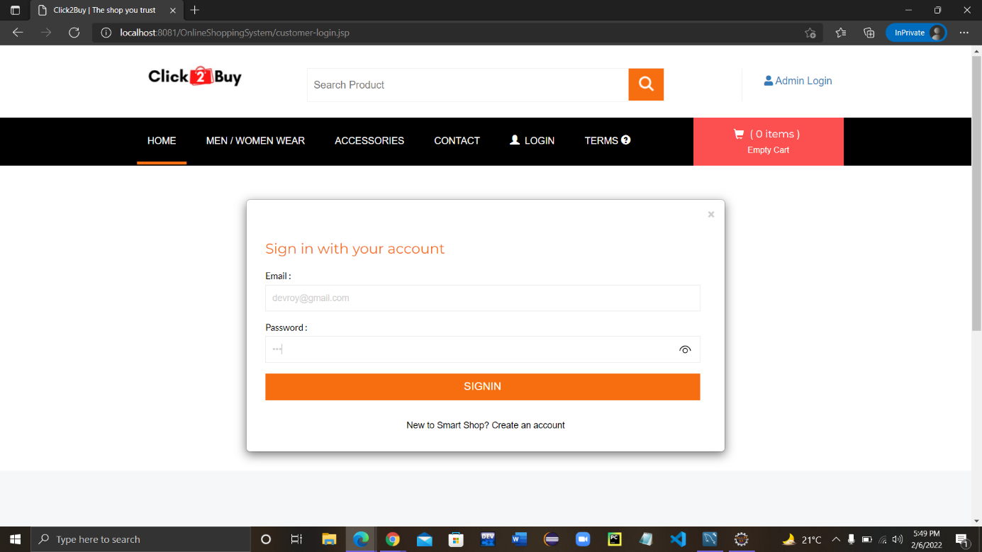
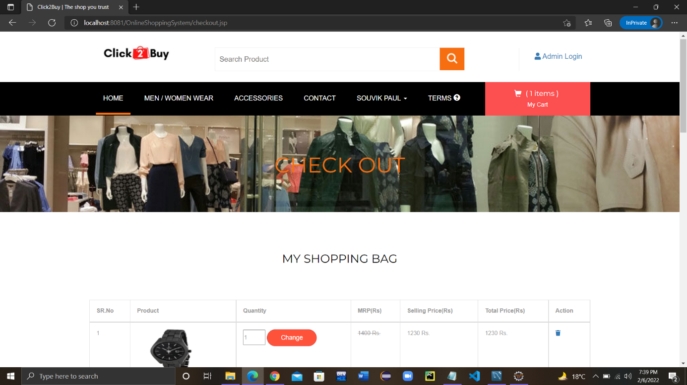
Website Pages & Database demonstrations
Sign in:
Cart:

Slide 25
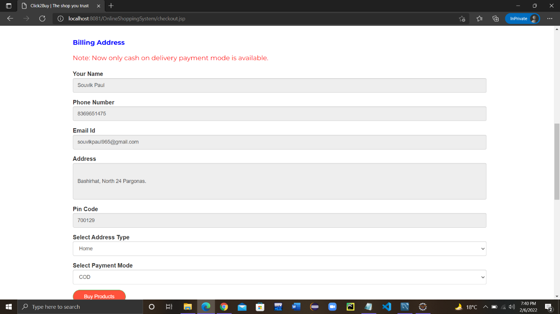
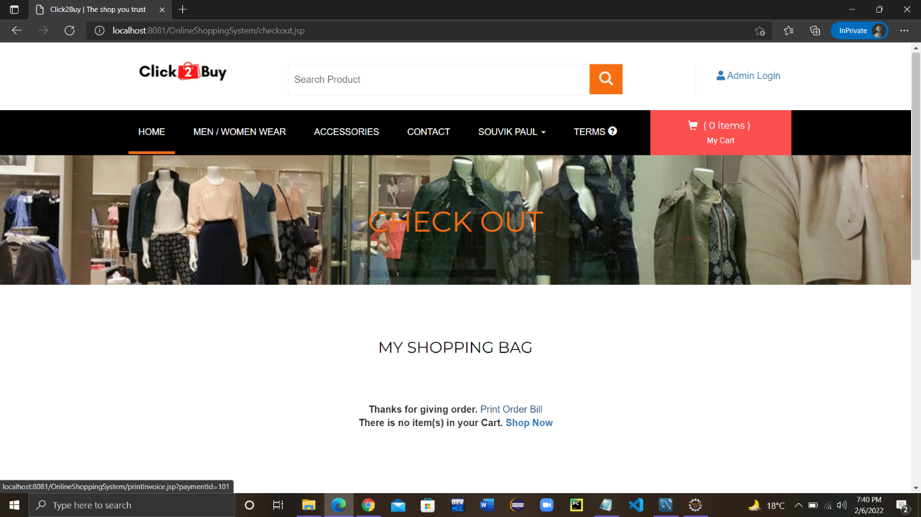
Website Pages & Database demonstrations
Address Info:
Order Conformation:

Slide 26
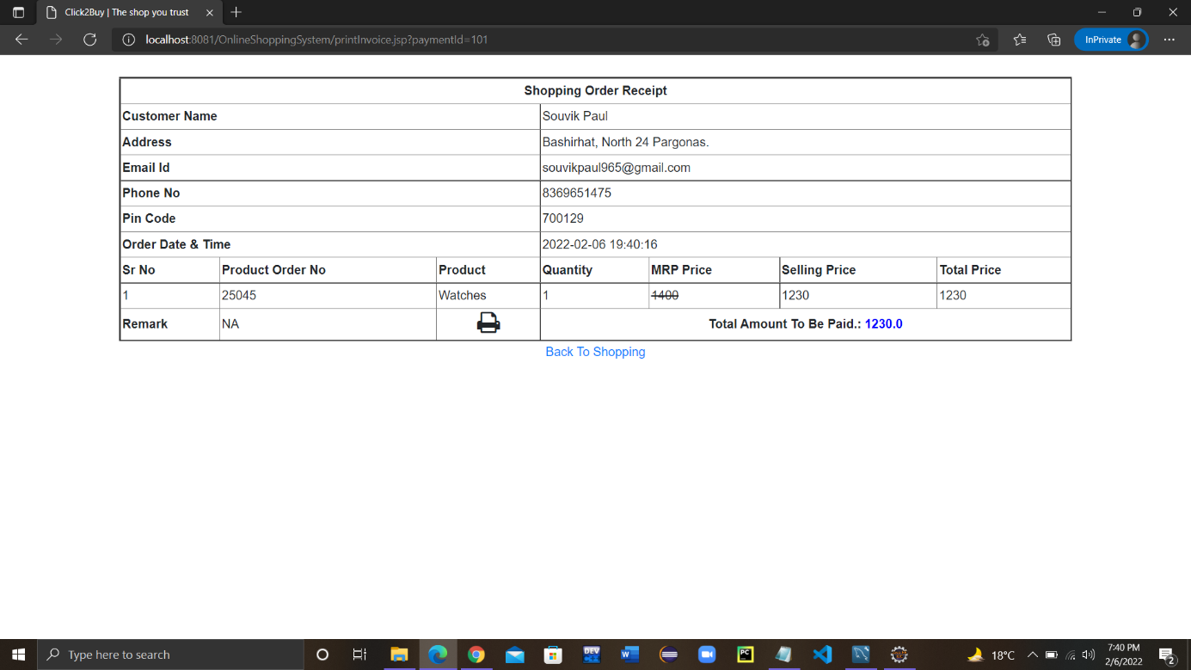
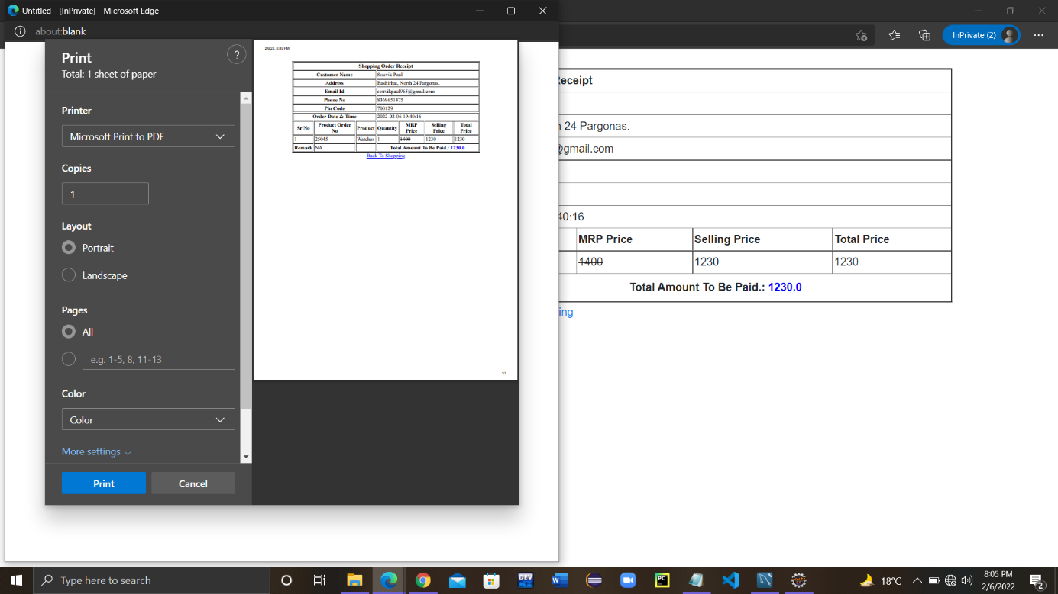
Website Pages & Database demonstrations
Order Bill:

Slide 27
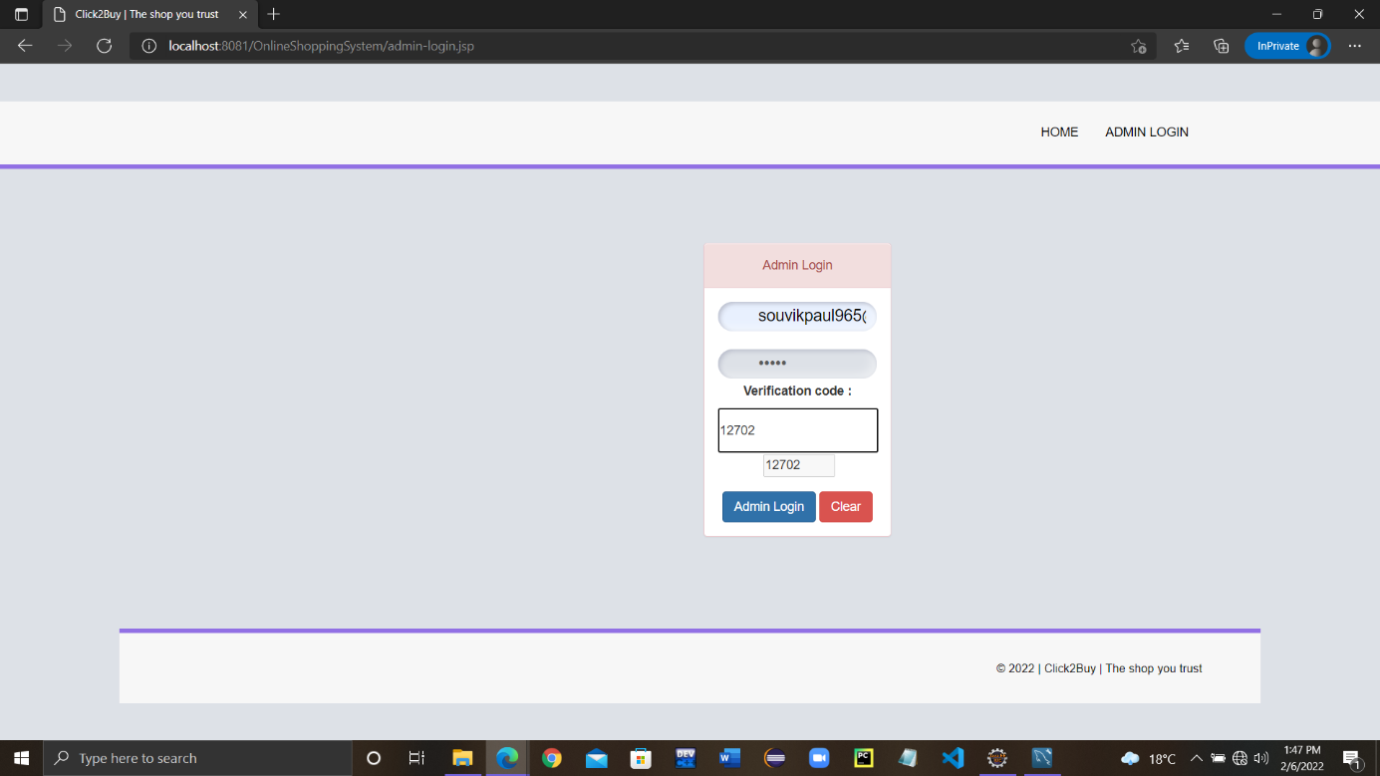
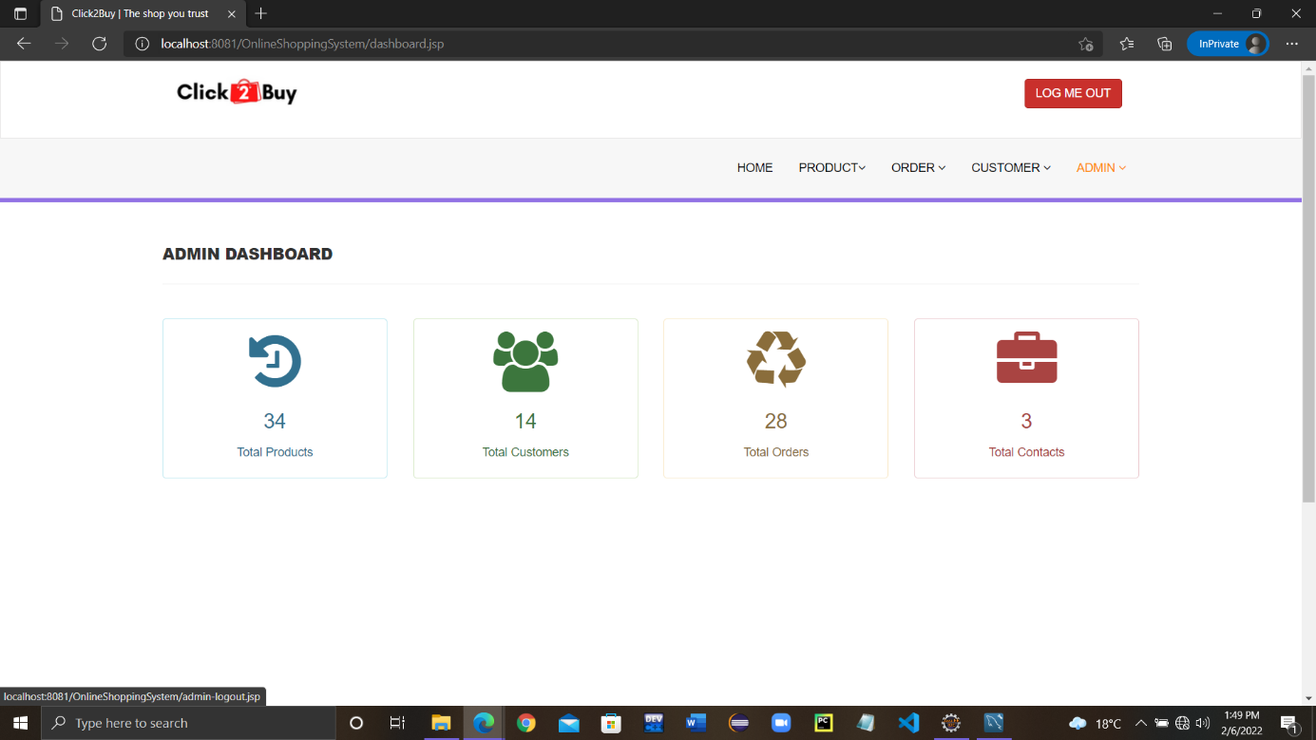
Website Pages & Database demonstrations
Admin Interface:
Login:
Dashboard:

Slide 28
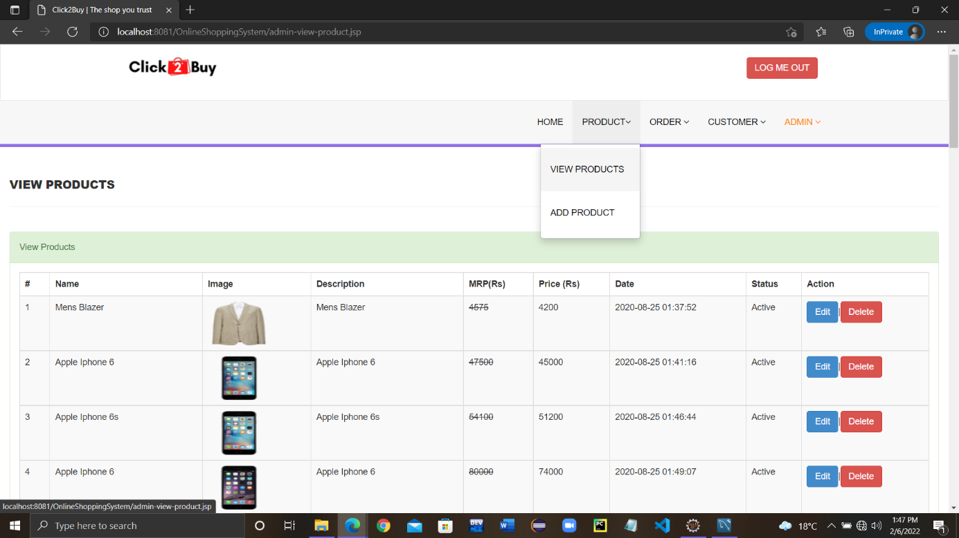
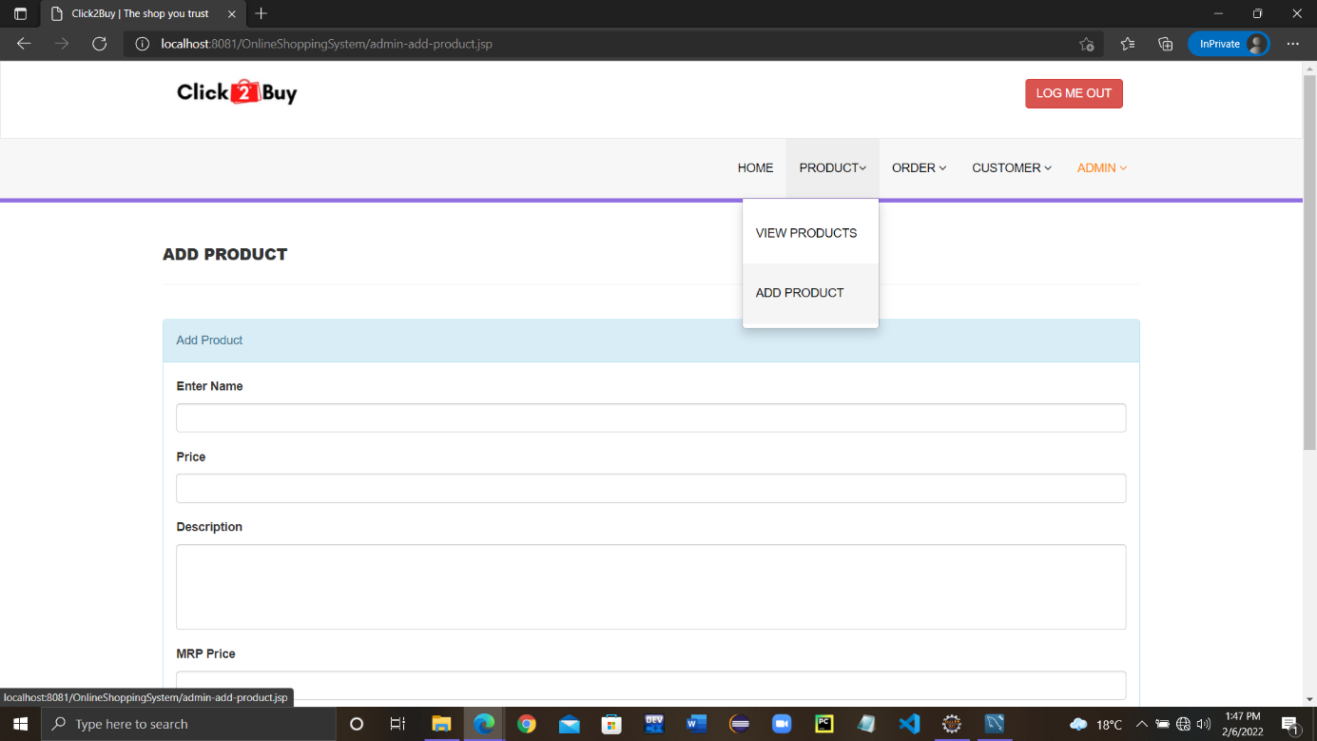
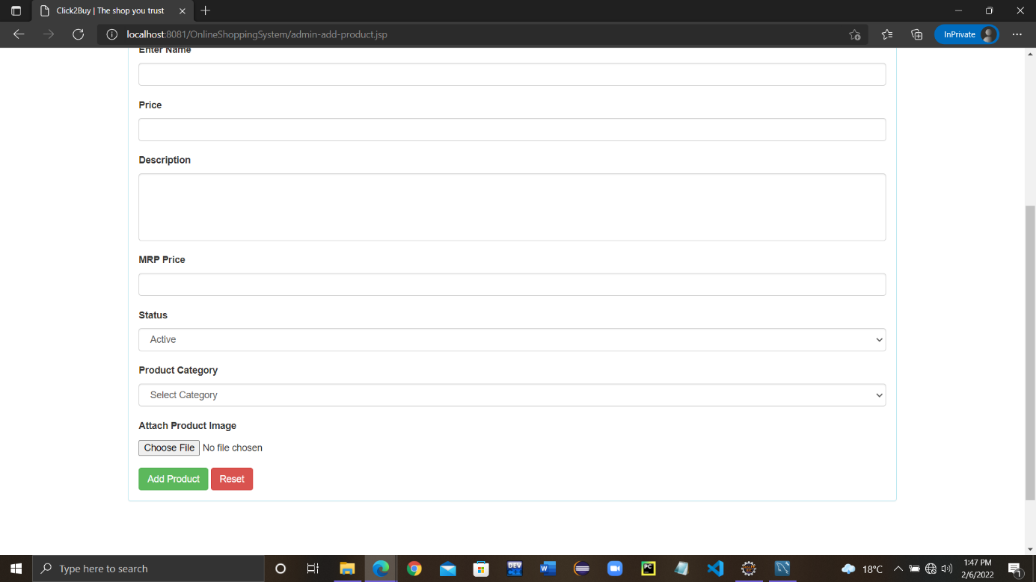
Website Pages & Database demonstrations
View Products:
Add Products:

Slide 29
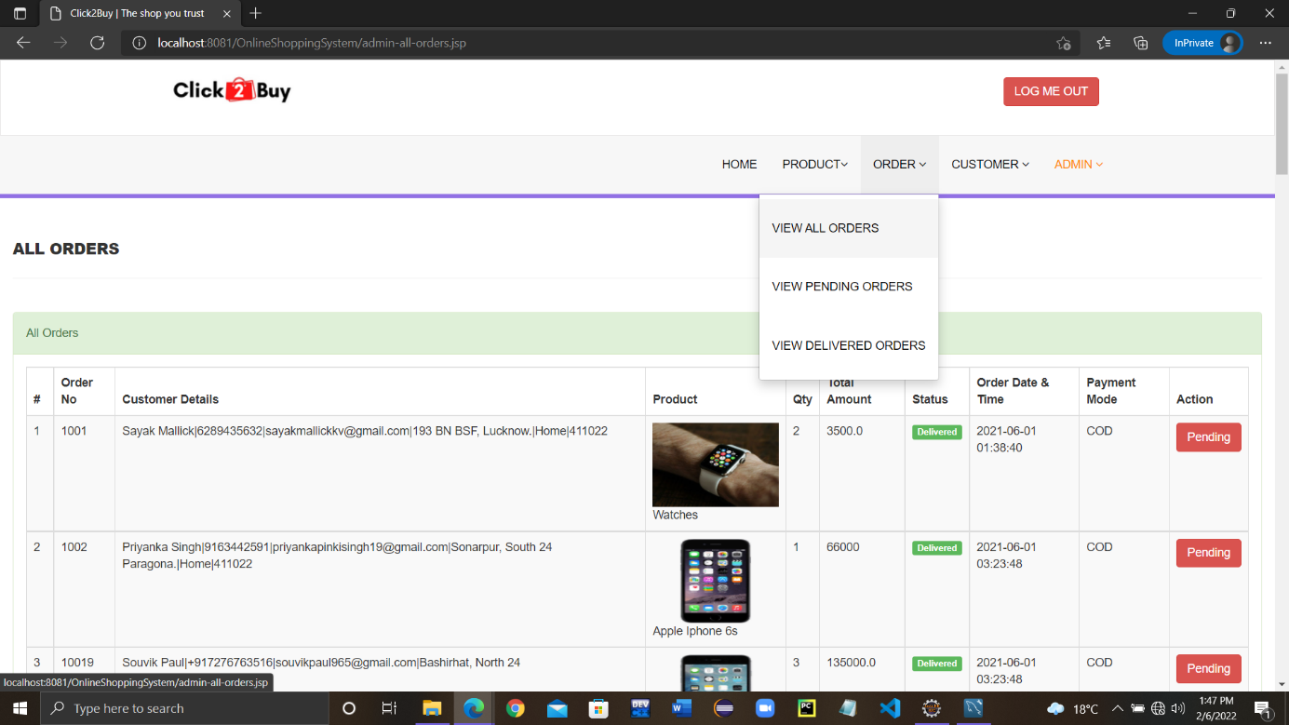
Website Pages & Database demonstrations
View All Orders:

Slide 30
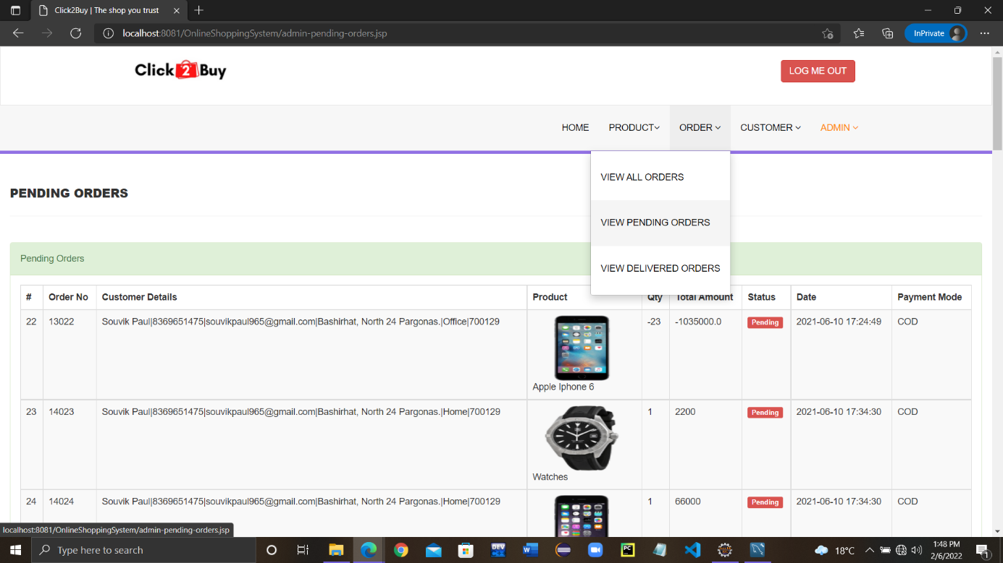
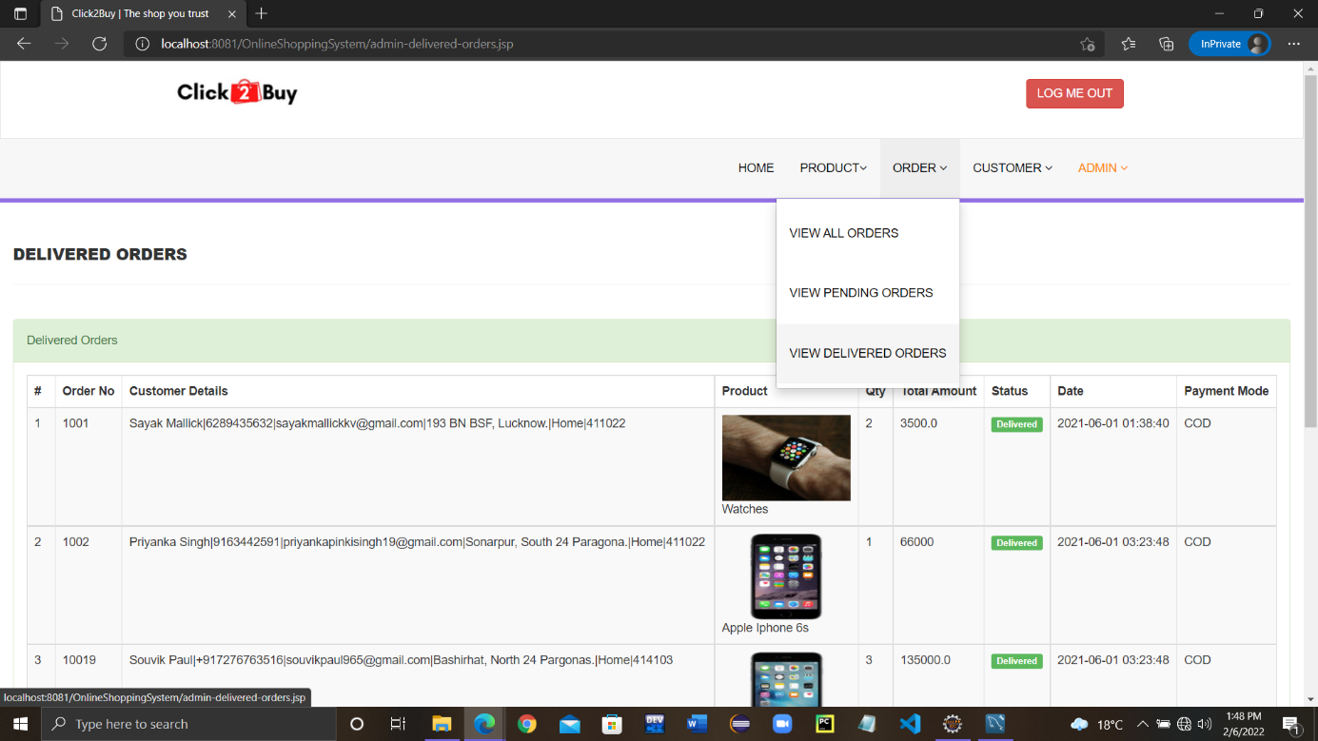
Website Pages & Database demonstrations
View Pending Orders:
View Delivered Orders:

Slide 31
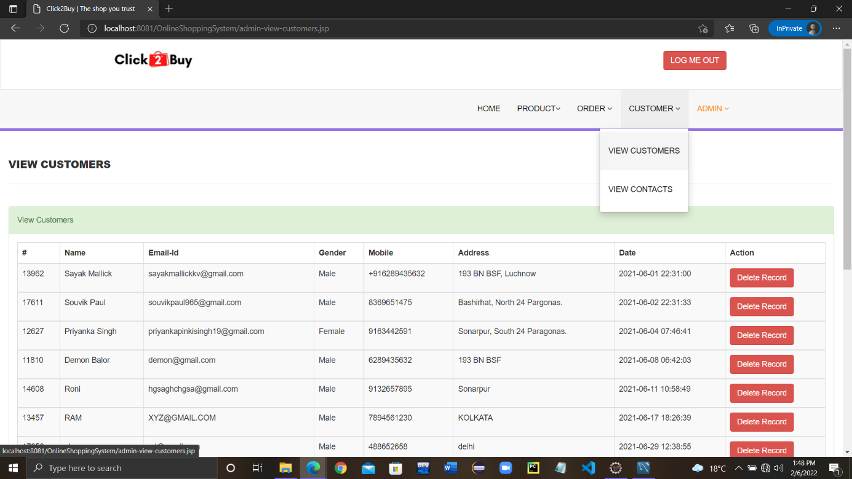
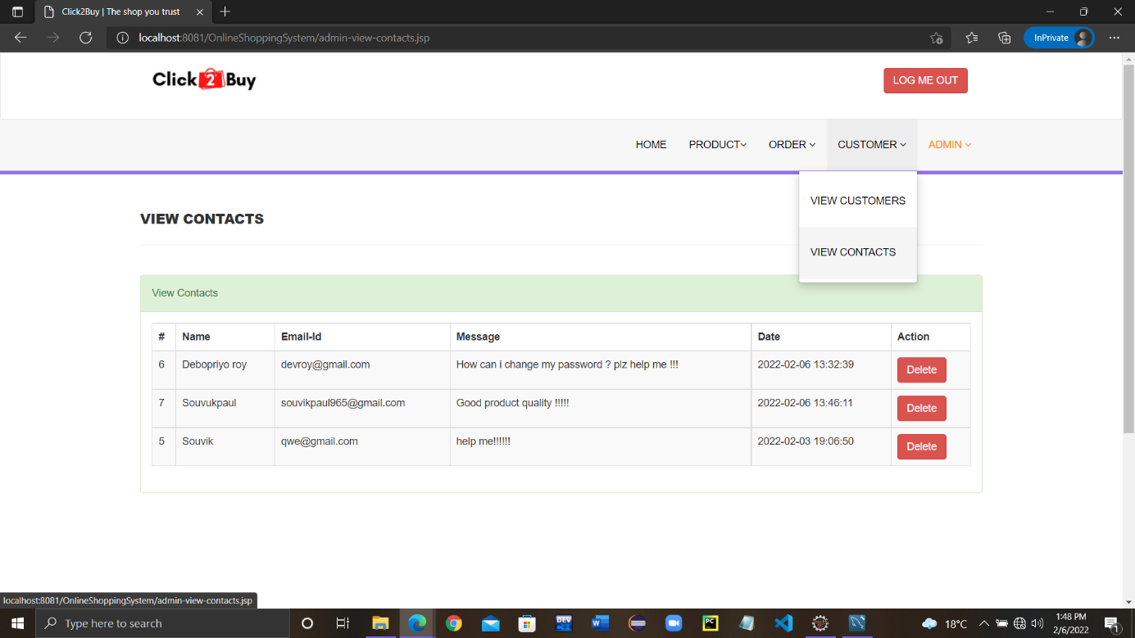
Website Pages & Database demonstrations
View Customers:
View Contacts:

Slide 32
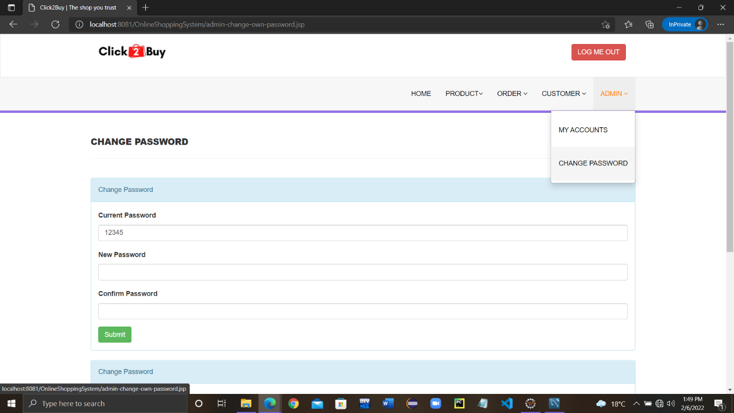
Website Pages & Database demonstrations
Change Password:

Slide 33
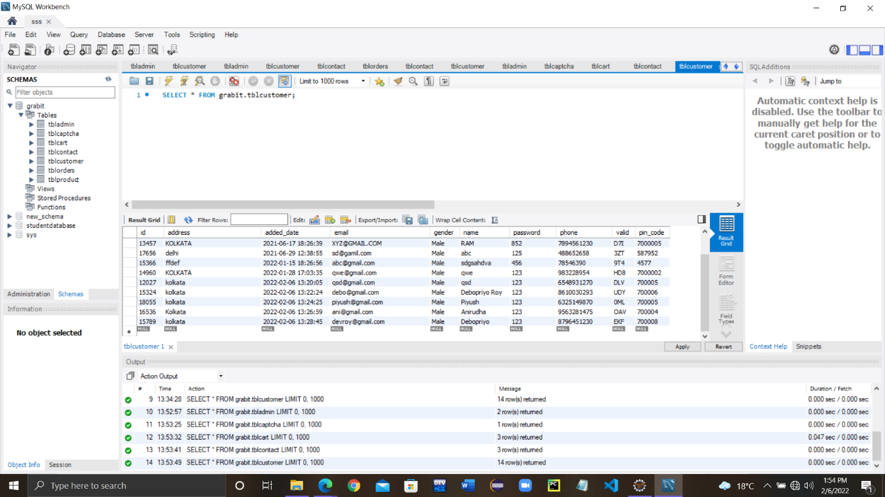
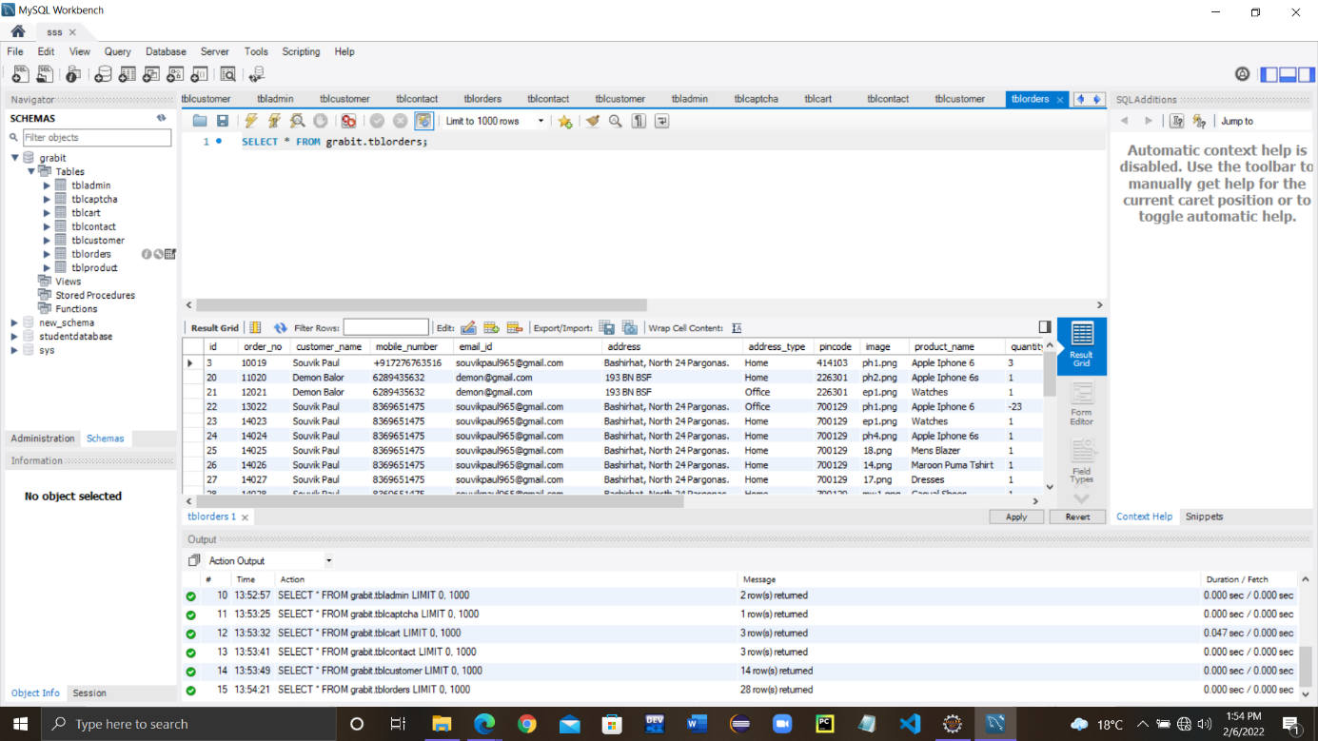
Website Pages & Database demonstrations
Database Tables:
Customers:
Orders:

Slide 34

Live Project Demonstration
GitHub: https://github.com/SouvikPaul20/Internship-Project-2022

Slide 35
FUTURE SCOPES AND LIMITATIONS
Scopes :
In the upcoming elevation, a segment for grocery is in thought of addition.
As a full-time work, warehouses can be established in various areas to reach far corners of the country with less duty period.
Medical services can be added far ahead with lead of quicker delivery.
Limitations :
Financial barrier can affect the progress; good amount of investment is required.
Situations like pandemic or natural disasters tend to delay or loss.
Network or service errors can interpose connectivity in various coordinates of the country.

Slide 36
conclusion
Working in the project engaged in vast research, that turns to upliftment of knowledge and skills. It was a great involvement to work as a team on the way to complete a foremost web application laterally with the report. Having deal with coding, the grip for programming languages have become tighter. However, there were many facts to know about the market especially which have bases on online entrepreneurship or e-commerce. In the time being, coming across peoples’ necessities with different rising query for a well satisfied application, information about the looked-for advancement have had been applied during the development.
Expectantly, very soon in future, this team will again sit together to make a notable step towards shifting the conviction of this application and establishment of a full-time firm.

Slide 37
BIBLIOGRAPHY
The following sources helped moderately in finalizing the project –
Books:
Professional Java for Web Application; by Nicholas S. Williams
MySQL and JSON: A Practical Programming Guide; by David R. Stokes
Web pages:
https://stackoverflow.com/
https://www.javatpoint.com/
https://www.geeksforgeeks.org/

Slide 38
THANK YOU!

